Slide 1
Minding yourself and others

Slide 2
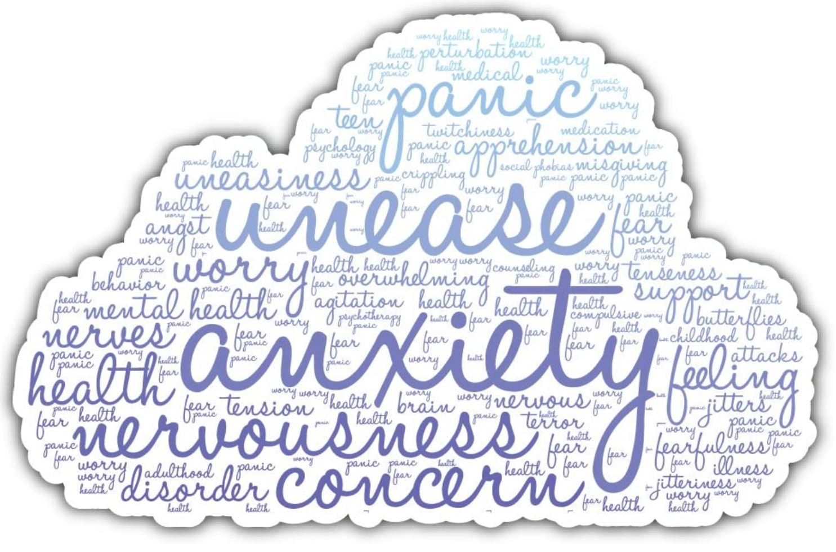
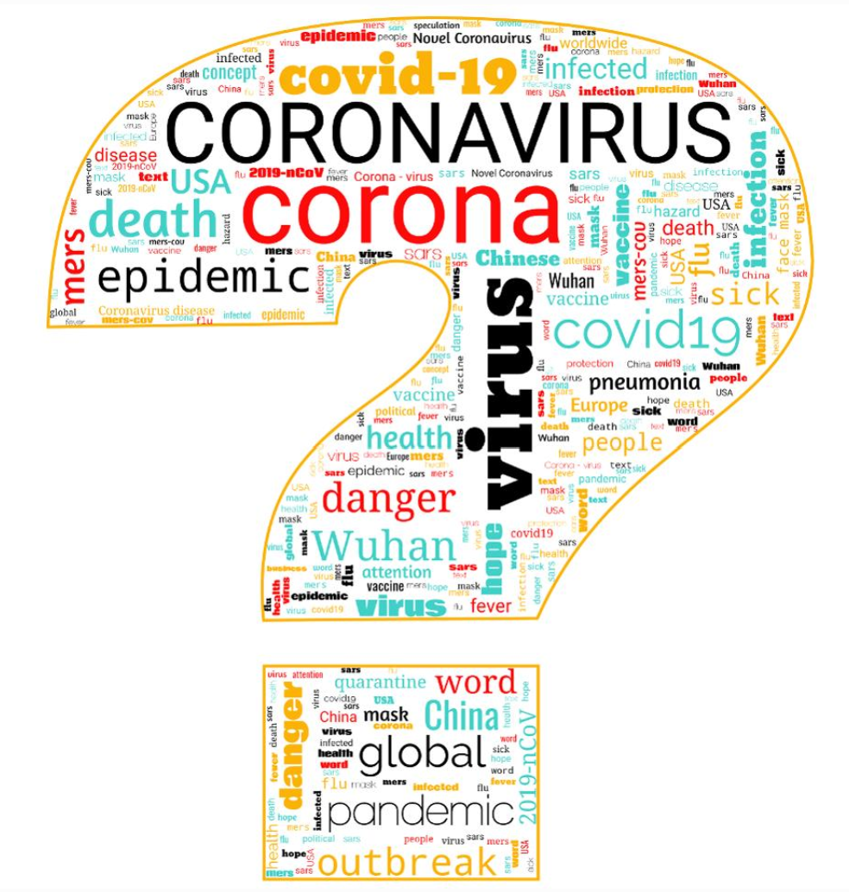

COVID-19

Slide 3
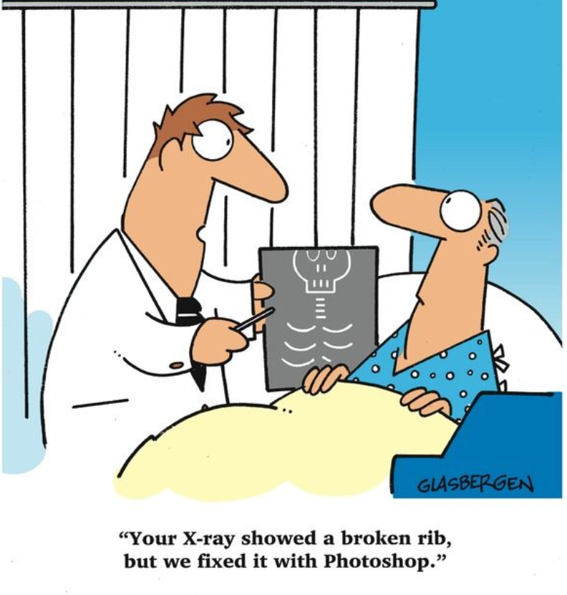
Our incredible minds(my experiences this week)
I woke from my sleep, not feeing great.
Our normal cough or sneeze prompts irrational thoughts
I dreamt I saw my own x-rays
This Covid-19 will test the most resilient of us.
And prompt anxious thoughts
But this is normal and expected (you must work to manage your mental health)

Slide 4
How our mental health might be affected.
You may notice some of the following in yourself:
increased anxiety
feeling stressed
finding yourself excessively checking for symptoms, in yourself, or others
becoming irritable more easily
Notes:
The spread of coronavirus is a new and challenging event. Some people might find it more worrying than others. Try to remember that medical, scientific and public health experts are working hard to contain the virus.
Most people’s lives will change in some way over a period of days, weeks or months. But in time, it will pass.

Slide 5
How our mental health might be affected.
You may notice some of the following in yourself:
feeling insecure or unsettled
fearing that normal aches and pains might be the virus
having trouble sleeping
feeling helpless or a lack of control
having irrational thoughts
Notes:
The spread of coronavirus is a new and challenging event. Some people might find it more worrying than others. Try to remember that medical, scientific and public health experts are working hard to contain the virus.
Most people’s lives will change in some way over a period of days, weeks or months. But in time, it will pass.

Slide 6
How to mind our mental health
We will get stressed, anticipate it and support each other
Set Limits
  News
  Social media
  Don’t engage in ‘chaos, speculative’ conversations
Keep a routine
  Regular exercise
  Eat healthy and balanced diet
  Practice relaxation techniques such as breathing exercises
  Read
Notes:
The spread of coronavirus is a new and challenging event. Some people might find it more worrying than others. Try to remember that medical, scientific and public health experts are working hard to contain the virus.
Most people’s lives will change in some way over a period of days, weeks or months. But in time, it will pass.

Slide 7
How to mind our mental health
Avoid excessive alcohol
Talk to your closest, especially your children about plans and how they are feeling
This is a distressing time, support each other

Slide 8
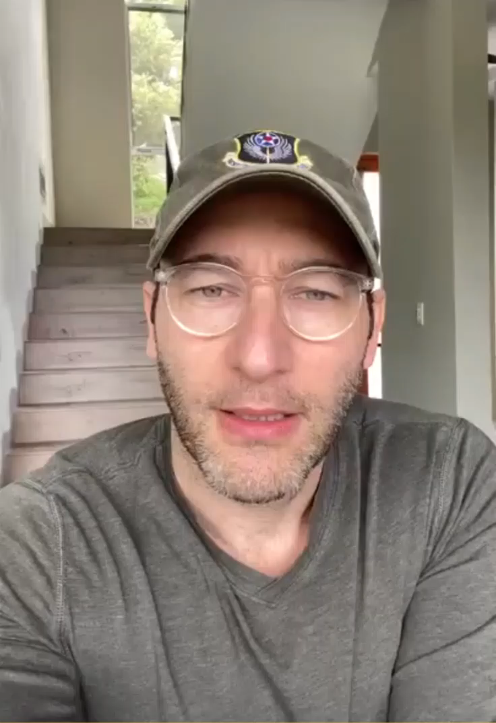
Simon SineK
I’m a great fan of Simon Sinek
His Infinite Mindset is a Leadership concept applicable here.
Here was his message to me yesterday
I’m sharing it for you all
Especially for those stressed.
Take care of yourself.
Be patient.

Slide 9
Our normal lives
Normal:
Normal may seem ordinary
But once it’s gone, you just want it back again.
Because the thing is, a normal life is a truly extraordinary one
“If we winter this one out, we can summer anywhere”
  Seamus Heaney

Slide 10
Virtual Coffee breaks
Finally, our organisation has organised a virtual ‘Coffee’ break every morning at 9 to 10am. Our colleagues log-on, video on or off, it’s up to the individual and we talk. We have colleagues in Ireland and across mainland Europe. ‘NO’ Covid conversation, Friendly family content, drying wood, making a descent cup of coffee, etc. It’s been the best thing I’ve done in an awful long time.
I’ve made some Spotify Play Lists. (1 hour each only) Enjoy and take the greatest care of yourselves.
Easy Listening
Motown Soul

